Slide 1
Installing PostgreSQL on Microsoft Windows
PBC details here

Slide 2
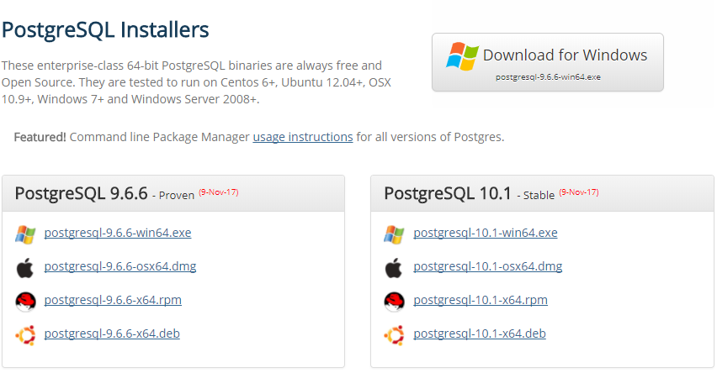
1. Download Installer
Go to the page:
https://www.openscg.com/bigsql/postgresql/installers.jsp/
Choose the version PostgreSQL 9.6.6 for and click Download for Windows.

Slide 3
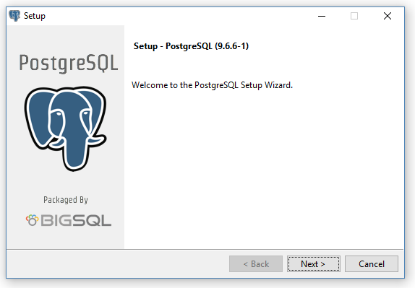
2. Run Installer
Run the installer PostgreSQL-9.6.6-1-win64-bigsql.exe and on the Welcome page click Next.

Slide 4
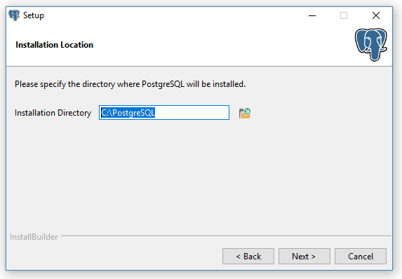
2.1. Installation directory
Choose suitable installation directory and click Next. The directory should have the rights to be written in by the installer. There is possibility that C:\PostgreSQL directory has restrictions.

Slide 5
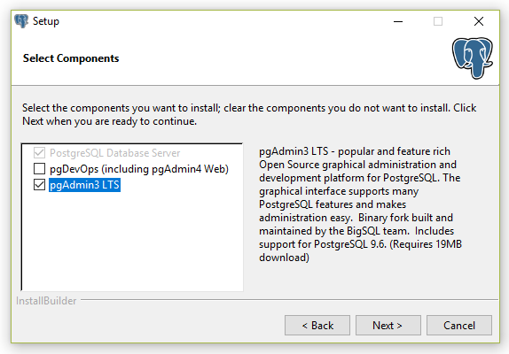
2.2. Components
Choose pgAdmin3 LTS as an additional component and click Next.

Slide 6
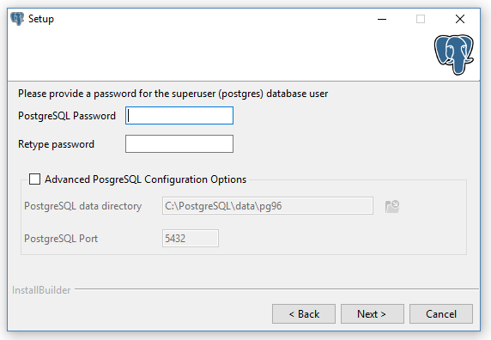
2.3. Create password
Create a password for a superuser and click Next.

Slide 7
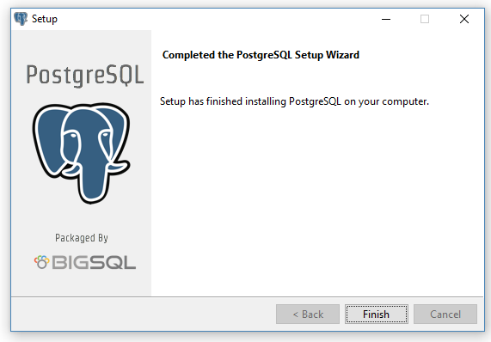
2.4. Summary and Installation
Review the summary of installation and proceed by clicking Next. Wait for the installation to finish.

Slide 8
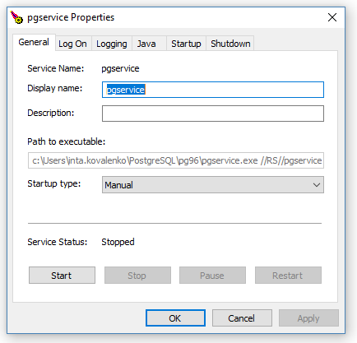
3. Start the database
Before anyone can access the database, you must start the database server. Go to the directory, where the PostgreSQL has been installed. Find the folder named pg96 and run the pgservicew.exe and press Start.

Slide 9
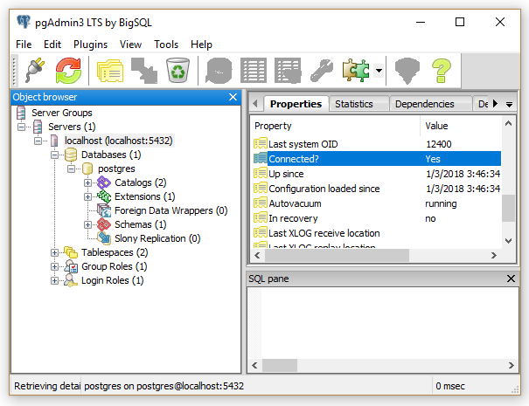
4. Run the pgAdmin3
In the directory, where the PostgreSQL has been installed, by the path pgAdmin3/bin find and run pgAdmin3.exe. Check if you can connect to localhost by clicking on it.

Slide 10
5. Install JDBC driver and add it to CLASSPATH
Go to the page to download a JAR:
https://jdbc.postgresql.org/download/postgresql-42.1.4.jar
You can install the driver by placing postgresql-42.1.4.jar in your classpath through the System Control Panel.

Slide 11
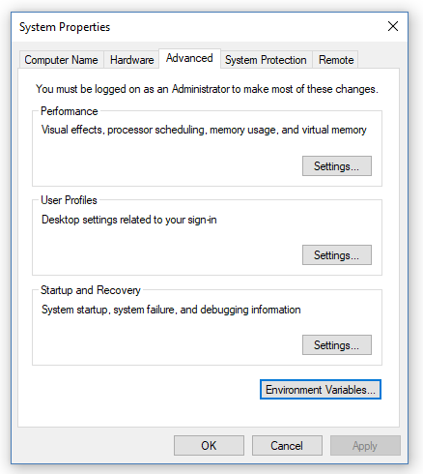
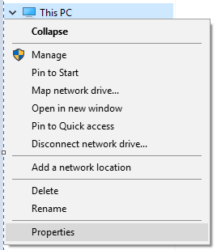
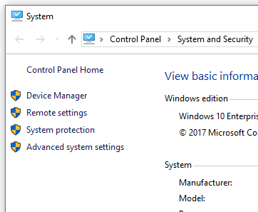

5.1. Locate Environmental Variables
To add a driver to your CLASSPATH, open File Explorer, click on This PC and choose Properties. In the System window choose Advanced system settings. In the System Properties window click on Environment Variables.

Slide 12
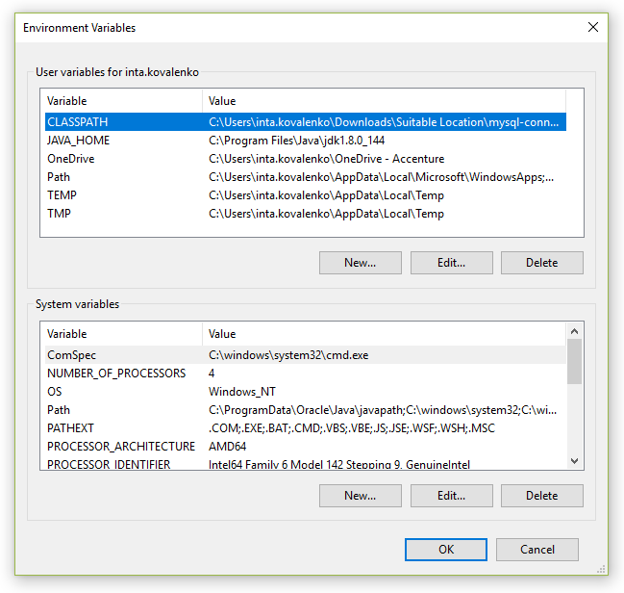
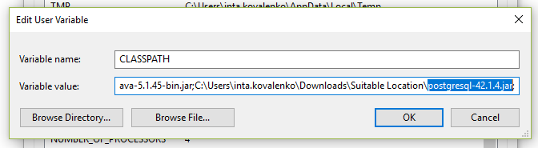
5.2. Edit variable CLASSPATH
In User variables you should already have a CLASSPATH variable. Click on Edit and add a path to JAR after semicolon. After that close all opened windows by clicking OK.

